Slide 1
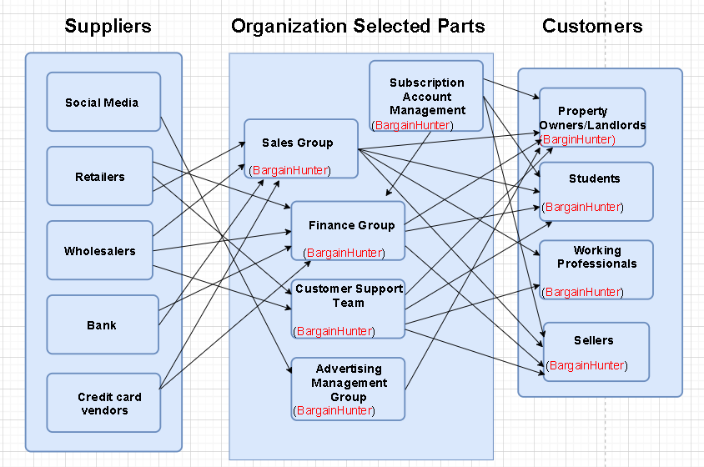
BargainHunter: Business Relationship Map

Slide 2
BargainHunter: SIPOC Diagram
S
I
P
O
C
Supplier
Inputs
Process
Outputs
Customers
User Inquires
Geographical
Information
Property Details(
Listings, Images)
Rental Prices
Marketing advertising
Transaction Details
Availability Status
Subscription Account Management
Booking Confirmations
Payment Transactions
Customer Queries Resolved
Customer Support Tickets
User Feedback
Social Media
Retailers
Wholesalers
Bank
Credit Card vendors
Property Owners/Landlords
Students
Working Professionals
Sellers
Sales Group
Finance Group
Customer Support Team
Advertising Management Group

Slide 3
User Roles by Business Group
External Users (Customers)
Property Owners/Landlords(Pariva)
Students (Bansari)
Working Professionals(Pankti)
Sellers(Shiva)
Internal Users
Team Members gather business requirements for their assigned business stakeholders.
Business Group | User Roles | Team Member Name (Bus. Group Proxy)
Subscription Account Management | Customer support | Shiva
Sales Group | Sales Manager | Yakshita
Finance Group | Budget Analyst Financial Analyst Accountant | Bansari
Customer Support Team | Social Media Support Specialist Live Chat support Agent | Pankti
Advertising Management Group | Marketing Strategist | Pariva

